Slide 1
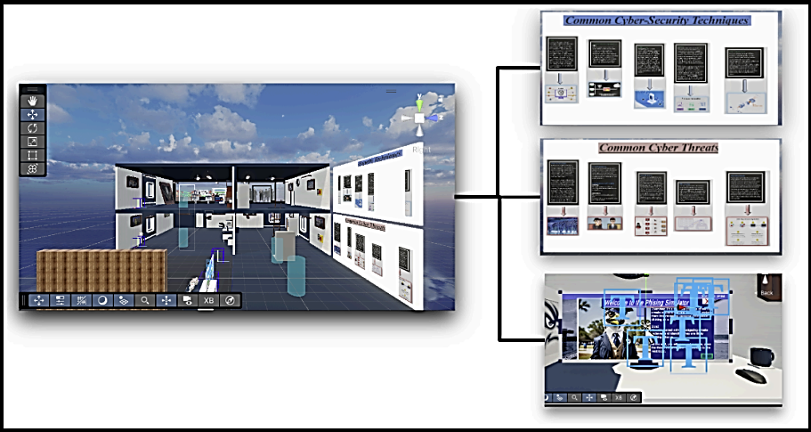
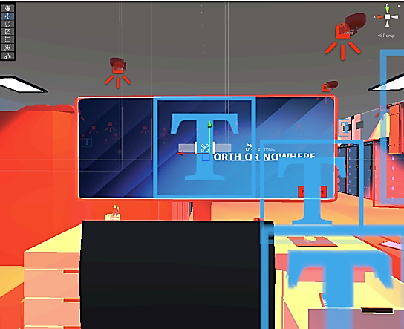
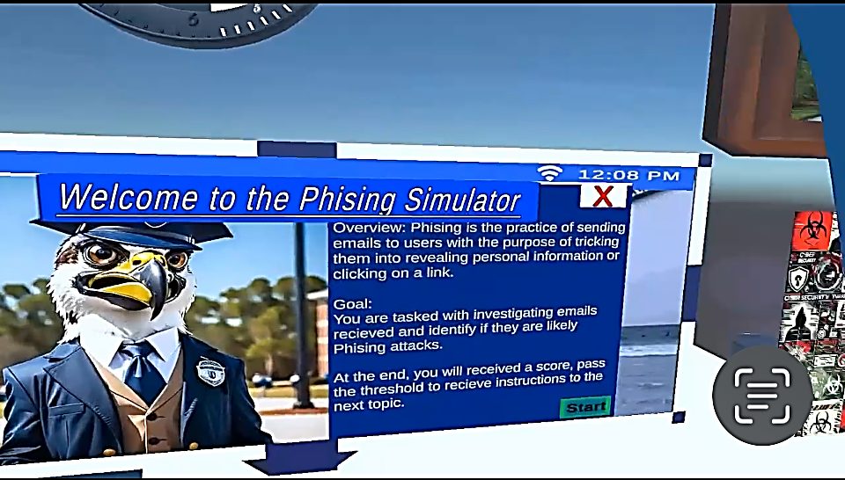
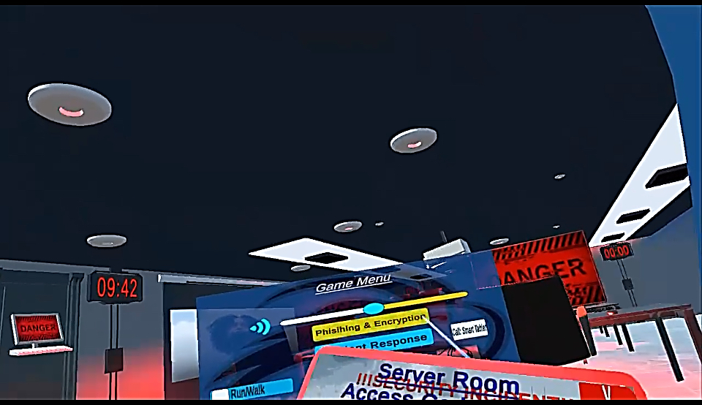
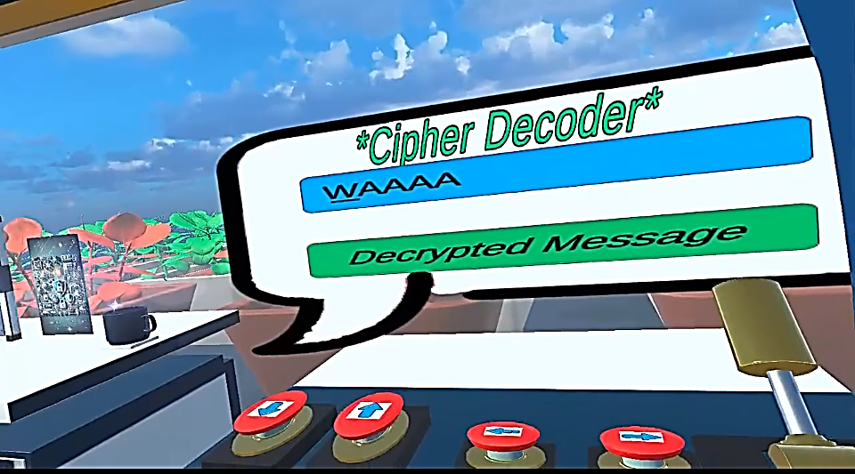
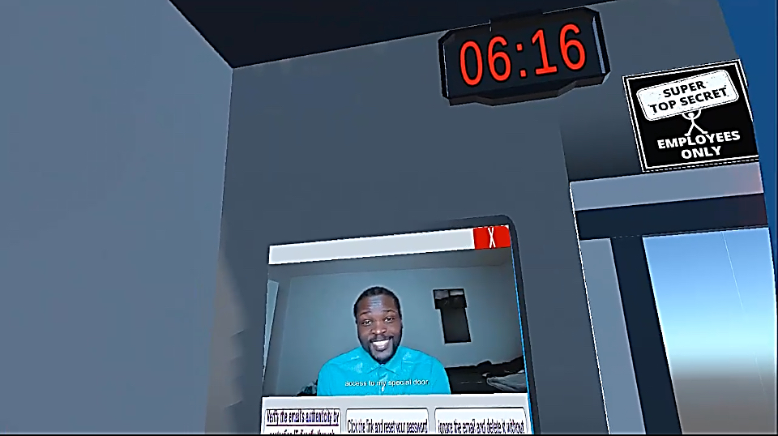
Cybersphere: An Educational VR Cybersecurity Game
Taiwo AO Onitiju
Master of Science Student, Cybersecurity
This poster represents my extended work started in the Computing Practicum course taken in the Fall 2024 semester.
School of Computing, University of North Florida
Introduction
Techniques & Threats
Incident Response
Problem Statement:
Cybersecurity education often relies on outdated, theory-heavy methods that lack practical experience. Students miss opportunities to practice dynamic attacks or defenses in realistic environments, leaving them unprepared for the workforce and increasing organizational vulnerabilities.
Design & Implementation
Development Process:
Concept Design – Created initial sketches and ideas for different training modules, focusing on real-world scenarios.
Prototype Development – Built a functional prototype using Unity and the Oculus Quest 3, allowing users to interact with the virtual environment.
Goal:
To boost users' readiness for real-world challenges, improves knowledge retention through interactivity, and provide a scalable VR tool for practical education
What is Cybersphere?
Future Development
Cybersphere is an innovative VR-based cybersecurity training platform that offers interactive learning experiences in key areas of cybersecurity. Instead of relying on traditional textbook methods, it provides users with a realistic, engaging, and problem-solving approach to understanding cyber threats.
Encryption plays a crucial role in protecting sensitive data from unauthorized access.
Phishing is one of the most common cyber threats, where attackers deceive users into revealing sensitive information through fraudulent emails, websites, or messages.
Cybersphere’s Techniques & Threats module helps users:
Recognize the warning signs of phishing attacks through interactive scenarios.
Learn how attackers manipulate human psychology to steal credentials.
Apply decryption techniques to locate secure information.
Incident response (IR) is a critical aspect of cybersecurity, involving the identification, containment, and mitigation of security incidents. Without proper training, professionals may struggle to respond effectively under pressure.
Cybersphere’s Incident Response module provides users with:
Scenario-Based Training: Users experience a live cyberattack, where they must follow structured IR procedures.
Interactive Escape Room Concept: A simulated cyber breach forces users to react quickly, analyzing threats and implementing defensive actions.
Malware Analysis
As cyber threats continue to evolve, it is essential to train professionals in malware analysis and forensic techniques. The next phase of Cybersphere’s development will introduce a Malware Analysis Module, allowing users to:
Investigate malware-infected files in a VR forensic lab.
Use digital forensic tools to uncover hidden data and analyze malicious code.
Key Modules:
Cybersecurity Techniques & Threats (Phishing & Encryption).
Incident Response (Simulated breach handling).
Threat Analysis (Malware & Digital Forensics).
Target Audience: Students, educators, and entry-level IT professionals.
Acknowledgments
Thang Pham & Zoe Elliott

